Slide 1

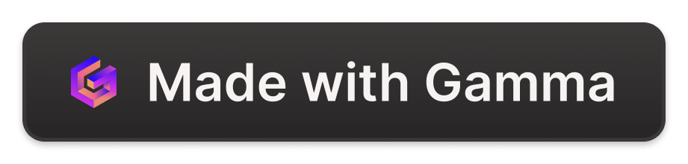
Enterprise Solution Architect at NAC Kazatomprom
I've had the opportunity to work as an Enterprise Solution Architect at NAC Kazatomprom, a leading uranium producer. This role has provided me with valuable experience in enterprise architecture, TOGAF methodology, and ARIS tool implementation.

Slide 2
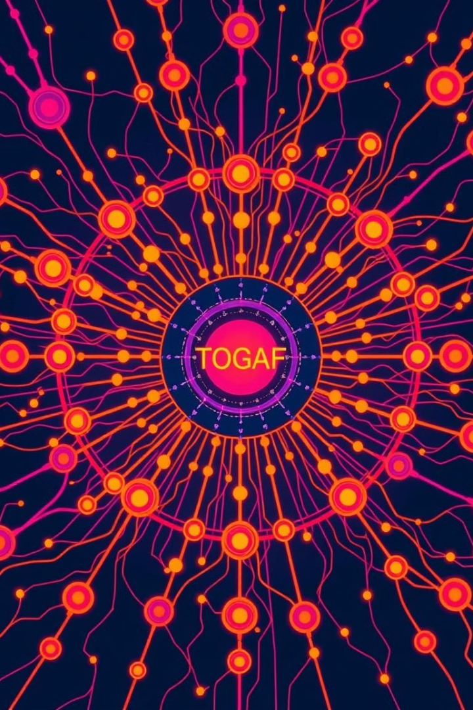
TOGAF Methodology Overview
The TOGAF methodology provides a framework for developing and managing enterprise architecture. It offers a structured approach to defining, documenting, and governing IT systems and processes.
1
Standardization
2
Governance
TOGAF promotes standardization and consistency across the enterprise, ensuring alignment between IT and business objectives.
It establishes a robust governance framework for managing and controlling architectural changes, minimizing risks and ensuring compliance.
3
Reusability
4
Flexibility
TOGAF emphasizes reusability of architectural components, reducing development time and costs while enhancing efficiency.
It allows for flexibility and adaptation to changing business needs, ensuring the architecture remains relevant and supports future growth.

Slide 3

ARIS Tool Introduction
ARIS is a powerful software tool that supported enterprise modeling and analysis. It provided comprehensive features for modeling business processes, data structures, and IT systems in our Project.
Process Modeling
Data Modeling
ARIS allowed us to design detailed processes, enabling organizations to visualize and analyze business workflows, identify bottlenecks, and optimize operations.
It facilitated data modeling, helping organization understand data relationships, dependencies, and potential data quality issues.
IT System Modeling
Reporting and Analysis
ARIS supported IT system modeling, enabling me to map IT infrastructure, applications, and services, ensuring consistency and integration.
The tool provided comprehensive reporting and analysis capabilities, allowing us to generate insights, track performance, and make informed decisions.

Slide 4
Designing Enterprise Architecture using TOGAF
TOGAF provided a structured approach to designing NAC Kazatomprom architecture, guiding organization through a phased process of defining, documenting, and governing IT systems and processes.
Architecture Vision
1
Defining the overall vision and goals for the enterprise architecture, aligning it with business objectives.
2
Business Architecture
Modeling the business functions, processes, and organizational structure to understand the business landscape.
Data Architecture
3
Defining data models, data standards, and data management strategies to ensure data consistency and integrity.
4
Application Architecture
Designing and specifying the application landscape, including application systems, interfaces, and integration points.
Technology Architecture
5
Defining the underlying infrastructure, including hardware, software, networks, and communication technologies.
6
Implementation and Governance
Implementing the architectural design, establishing governance processes, and managing ongoing changes.

Slide 5
Implementing TOGAF at NAC Kazatomprom
We implemented TOGAF at NAC Kazatomprom to standardize and govern enterprise architecture, aligning IT with business goals and ensuring consistency across the organization.
Architecture Vision
Architecture Development
Architecture Governance
Defined the overarching vision for enterprise architecture, aligning it with NAC Kazatomprom's strategic objectives.
Developed detailed architectural specifications for various business domains, including mining, processing, and sales.
Established a robust governance framework to manage architectural changes, ensure compliance, and minimize risks.

Slide 6
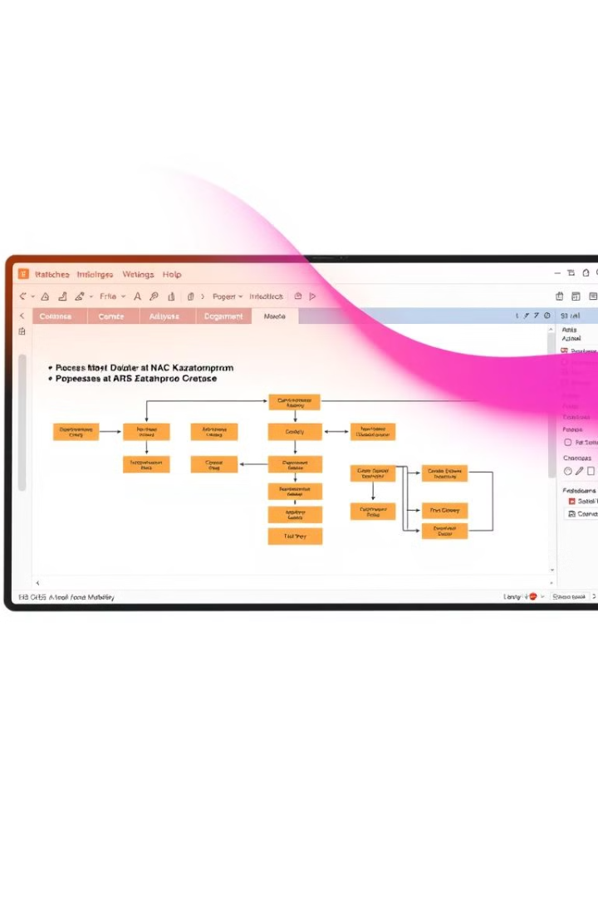
Utilizing ARIS for Enterprise Modeling and Analysis
We leveraged ARIS for enterprise modeling and analysis to gain a comprehensive understanding of NAC Kazatomprom's business processes, data structures, and IT systems.
Process Modeling
Modeled key business processes, identifying bottlenecks and areas for improvement.
Data Modeling
Developed data models to ensure data consistency, integrity, and alignment with business requirements.
IT System Modeling
Mapped IT infrastructure, applications, and services, ensuring integration and consistency.
Reporting and Analysis
Generated reports and insights to support decision-making and track performance.

Slide 7
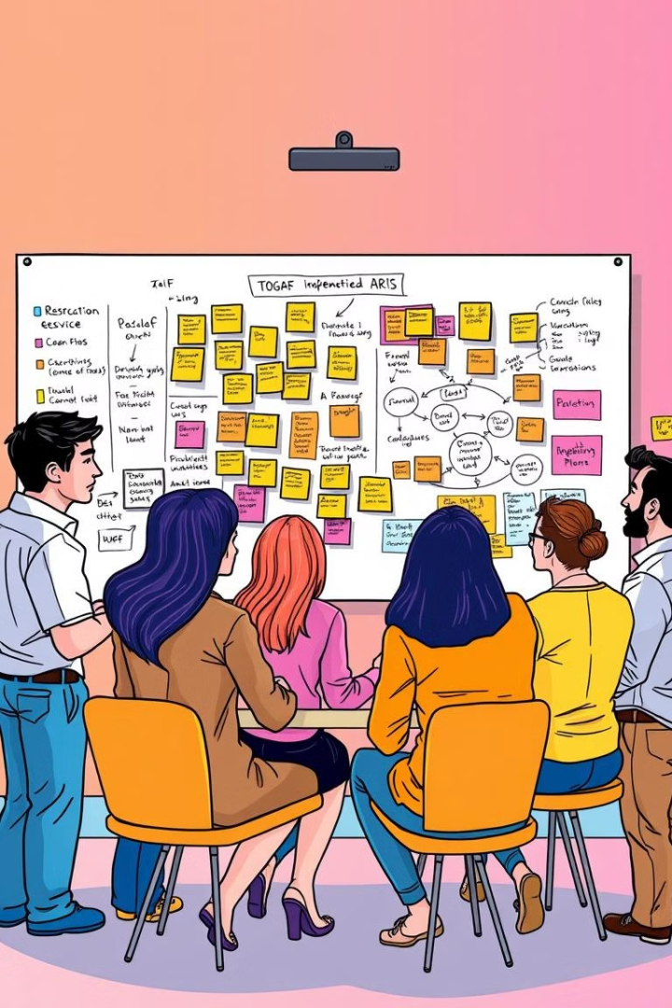



Challenges and Lessons Learned
Implementing TOGAF and ARIS presented several challenges, but we learned valuable lessons from the process.
Resistance to Change
Overcoming resistance to change from stakeholders who were accustomed to traditional ways of working.
Data Quality
Ensuring the quality and consistency of data used for enterprise modeling and analysis.
Skills Gap
Bridging the skills gap by providing training and mentorship to ensure successful adoption of TOGAF and ARIS.

Slide 8
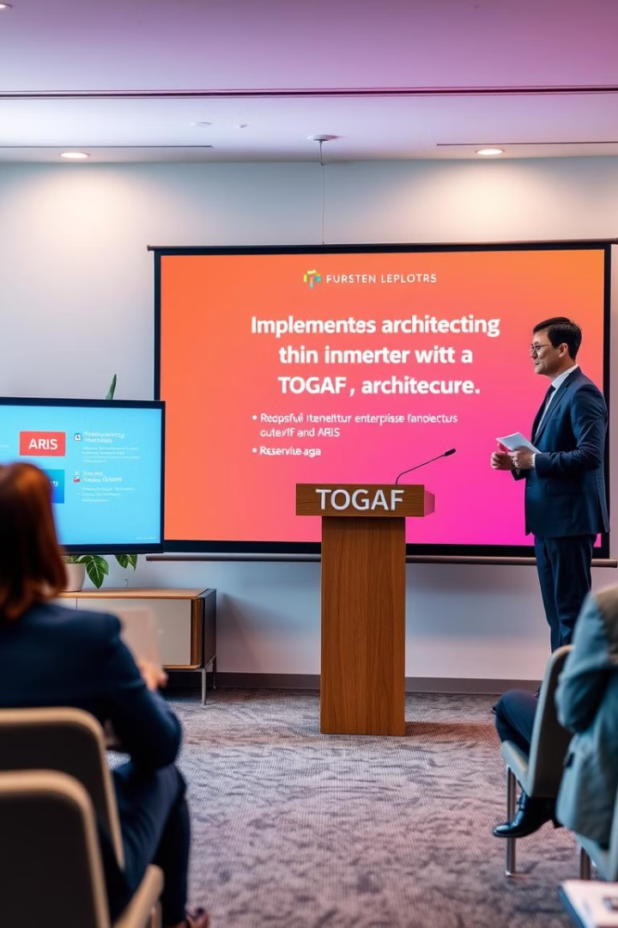
Conclusion and Key Takeaways
Our experience implementing TOGAF and ARIS at NAC Kazatomprom has demonstrated the benefits of a structured approach to enterprise architecture.
Thank you!
Questions?

